Slide 1
Complications of pediatric diabetes
Dr. Hosein Shabani Mirzaee
Pediatric Endocrinologist
Bahrami Children’s Hospital
TUMS

Slide 2
Tissue Injury Mechanism
Hyperglycemia increases the production of superoxide by mitochondria which impairs tissue repair by damaging DNA.
Insulin deficiency increases the oxidation of fatty acids in the vascular endothelium.

Slide 3
Tissue Injury Mechanism
Increased ROS inhibits the anti-atherogenic enzymes NOS & PCS and accelerates the process of atherogenesis.
By increasing the glucose concentration, the polyol pathway is activated.
Glycosylation of tissue proteins

Slide 4
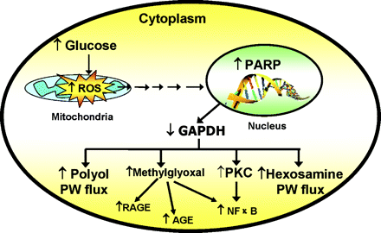
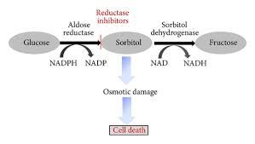
Tissue Injury Mechanism

Slide 5
Vascular Complications
Micro-vascular
Retinopathy
Nephropathy
Neuropathy
Macro-vascular
Coronary Artery Disease
Cerebrovascular events

Slide 6
Micro-vascular complications
Retinopathy
It is the most common cause of acquired blindness in developed countries.
Non-proliferative and proliferative
Macular edema, vitreous hemorrhage
Strategies : Proper control of blood sugar, screening by periodic examinations

Slide 7
Micro-vascular complications
Nephropathy
The most common cause of ESRD
First stage( microalbuminuria) :
Urine Albumin > 30mg/24h
Nephropathic stage (macroalbuminuria) :
Urine Albumin > 300mg/24h
Strategies : Proper control of blood sugar, periodic screening, Food protein restriction, Use ACEI

Slide 8
Micro-vascular complications
Neuropathy
Early signs include a lack or reduction in the heel reflex and a decrease in the sense of touch or vibration
Dysfunctions of the autonomic nervous system
Strategies : Proper control of blood sugar, Aldose reductase inhibitors, Alfa lipoic acid, Anti-covulstants, Anti-depressants

Slide 9
Macro-vascular complications
CAD and CVA
The most common cause of death in people with diabetes
Strategies : Proper control of blood sugar, Early diagnosis and treatment of dyslipidemia and hypertension, smoking cessation

Slide 10
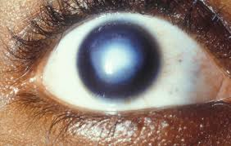
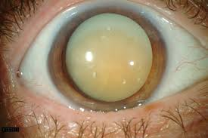
Non-vascular complications
Cataract and corneal opacity

Slide 11
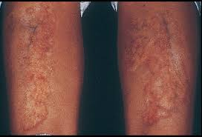
Non-vascular complications
SKIN
Necrobiosis lipoidica diabetcorum

Slide 12
Non-vascular complications
JOINTS
Limited joint mobility

Slide 13
Non Vascular Complications
SKELETON
T1DM is associated with increased risk of fracture
T1DM is associated with low bone mineral density

Slide 14
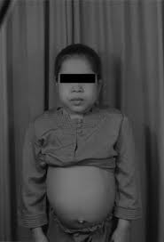
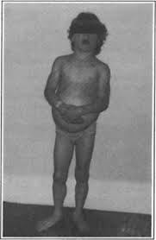
Non-vascular complications
GROWTH
Mauriac syndrome

Slide 15
Non-vascular complications
EATING DISORDERS
It is more common in adolescents
F / M : 2/1
Anorexia and bulimia nervosa
The risk of developing hypoglycemia and diabetic ketoacidosis increases

Slide 16
Reproductive Complications
Studies have not shown hypogonadism in boys, or any significant effect on ovulation, but a slight delay have been seen in girls’ menarch

Slide 17
Brain complications
Studies have shown that in children with contineus dysglycemia ( sever hypoglycemia and prolonged hyperglycemia) there is white matter change in temporal and parietal lobe, which affects the children's intelligence and cognition

Slide 18
Acute Complications
DKA
Cause: Lack or decrease of insulin with an increase in counter-regulatory hormones
Symptoms & signs: nausea, vomiting, decreased level of consiosness, abdominal pain, tachypnea, dehydration
Biochemical Criteria :
BS > 200 mg/dl
PH < 7.3 &/ HCO3 < 15
Ketonemia & Ketonuria

Slide 19
Acute Complications
HYPOGLYCEMIA
The most common acute complication of insulin therapy
Blood sugar less than 70 mg per deciliter
Symptoms & signs:
Autonomic: Sweating, palpitations, chills, hunger
Neuroglycopenic: Confusion, abnormal behavior, slurred speech, seizure, coma

Slide 20
Management of Hypoglycemia
In case of normal consciousness: 15 grams of oral glucose
In case of decreased level of consciousness: Glucagon ampoule 0.5 mg for under 5 years and 1 mg for over 5 years
In the emergency ward: intravenous glucose
0.3 g / kg (3cc / kg DW10%)

Slide 21
Auto-immune Disorders
Celiac disease
Lymphocytic thyroiditis
Adisson disease
Pernicious anemia

Slide 22
Screening guideline
 | INITIAL SCREENING | FREQUENCY | TEST
Thyroid disease | At diagnosis | Every 1-2 yr or sooner if symptomps | TSH, thyroid Ab
Celiac disease | At diagnosis | Within 2 yr or sooner if symptomps | TTG and IgA
Hypertension | At diagnosis | Each visit | Elevated BP based on 90% <
Dyslipidemia | > 10 y/o at diagnosis | If abnormal : Annually | Goal LDL-C < 100 mg/dl
Retinopathy | T1DM > 3-5 yr When > 10y/o or puberty | Annually | Dilated eye exam
Nephropathy | T1DM > 5 yr When > 10y/o or puberty | Annually | Urine albumin excretion
Neuropathy | T1DM > 5 yr When > 10y/o or puberty | Annually | Foot examination

Slide 23
کودک 7 ساله مورد دیابت نوع 1 که بعلت قند خون نامطلوب ارجاع شده است. تشخیص بیماری کودک از 3 هفته قبل معلوم شده و تحت درمان با انسولین زیر جلدی قرار دارد. دوز درمانی و رژیم انسولین مناسب بوده و تغذیه دیابتی رعایت می شود، اما قند خون بیمار کماکان نوسان واضح دارد.
کدام اقدام زیر اولویت دارد :
الف) تغییر نوع انسولین
ب) استفاده از پمپ انسولین
ج) آزمایش عملکرد تیروئید
د) کاهش مقدار کربوهیدرات رژیم غذایی

