Slide 2
Variant Interpretation and Reporting
Across Laboratories
Dr. Nejat MAHDIEH
Dr. Saeideh KAVOUSI

Slide 3
Objectives:
Overview of the current framework for analysis and interpretation of sequence variants for monogenic disorders
Overview of key available resources and their utility with variant interpretation.

Slide 4
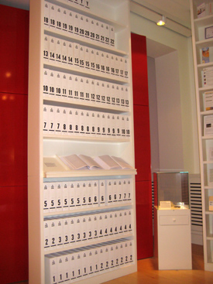
DNA code – Medicine now
3.4 billion units of DNA code:
127 volumes
1,000 pages per volume

Slide 5
Virtual Workflow for Clinical Genetics
Analysis Team
MP/MG
Biocurator
Treating Team
Genetic Counselor
Outside Faculty Expert (prn)
Test Request Patient and physician
request genome sequencing
for heritable disease through
EMR
Review by Genetic
Test Consultation Service
Genetic Counselor
Molecular Pathologist
Medical Geneticist
Establish questions being posed by
patient and treating team
Genetic?
Candidate variants and analysis approach
Clinical use

Slide 6
Virtual Workflow for Clinical Genetics
Insurance
authorization
Patient meets with genetic
counselor
Clinical counseling & consent
*Options for return of secondary findings
2-step consent process for non-actionable findings
Biobanking and data-sharing counseling & consent
Blood draw
1 tube for genome sequencing
1 tube for confirmatory studies and specimen ID
1 tube for biobanking (with appropriate consent)

Slide 7
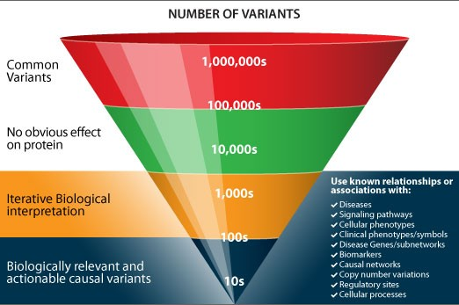
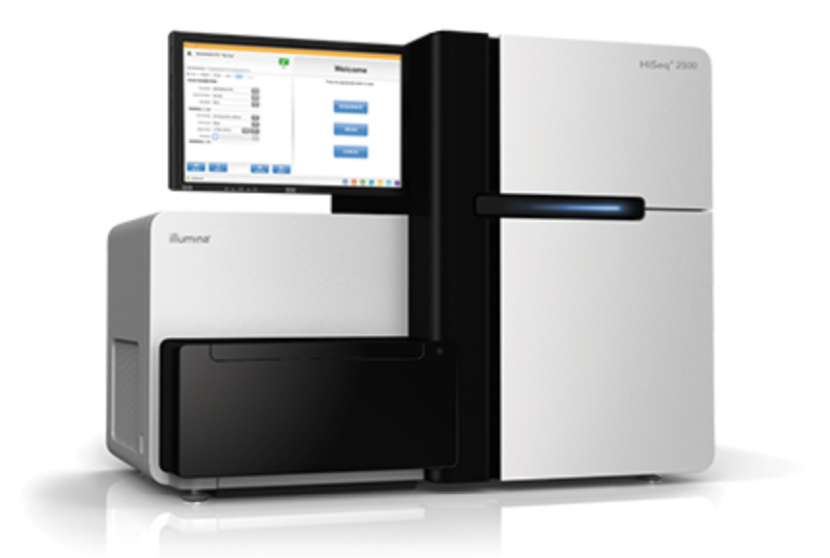
Virtual Workflow for Clinical Genetics
Illumina genome sequencing
Data analysis (open source, commercial, and Stanford developed):
Alignment
Variant calling
Quality management
ID and gender checks to confirm specimen identity
Variant filtering/prioritization
Phenotype
Inheritance pattern
Predicted deleterious
Secondary findings

Slide 8
Virtual Workflow for Clinical Genetics

Genomics Review Groups
Genomics Service
Treating Team
Content expert
Genomics Review Boards
Pediatrics
Cardiovascular
Oncology
Pharmacogenomics
Variant verification by orthogonal method
Segregation analysis
Curation meeting and
draft report

Slide 9
Virtual Workflow for Clinical Genetics
Final report generated and uploaded to EMR
Patient meets with genetic counselor and relevant members of treatment team
Yearly re-analysis upon request
Improved analysis
Improved sequencing
Increased medical knowledge

Slide 10
Delivering the full breadth of genomic testing
continuum OF Genomic Testing
Disease focussed
Informing treatment decisions
Population based
Predictive
And the full repertoire of testing technologies
TARGETED TESTIG
PANELS
EXOME SEQUENCING
WHOLE GENOME SEQUENCING
Known causes of genetic disease
eg Huntington’s Disease
Single test covering 10s – 100s of genes
Looking across the genome for diagnostic, therapeutic and predictive information
Inc. cascade testing to identify FH, BRCA, Lynch Syndrome
Standardising cancer panels for pan-solid tumour, pan-Haematological and specialist rare disease
Potential for PGx panel and polygenic risk scores
Standardising rapid NICU/PICU testing
Fetal Exome testing
Interim testing while WGS established
Phase 1 – 21 rare disease conditions and 3 cancers
Phase 2 – additional 25 rare disease conditions

Slide 11
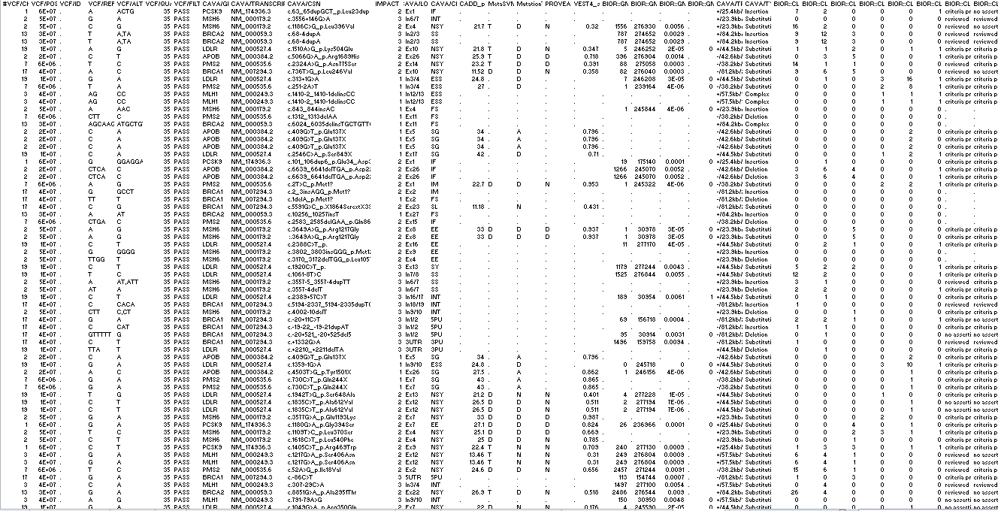
Mutation Type
And
Location
In-Silico Predictors
Populational
Allele Frequency
Gene

Slide 12
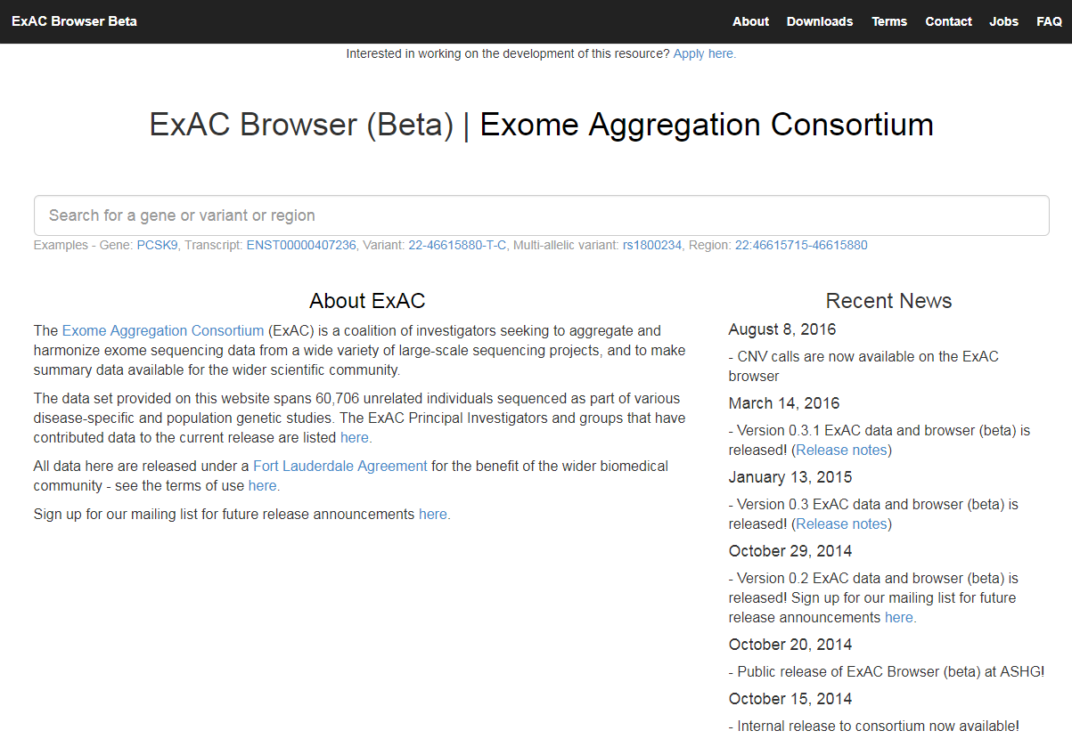
gnomAD and ExAC
Benefits
Free public databases since 2014
Data coming from over 138,000 exomes and genomes
Robust allele frequencies
Multi ethnic (sup-pop AFs)
Severe pediatric disease excluded
Version with cancer cases excluded
Accessible quality metrics and IGV views
Drawbacks
Phenotype data largely not available
Exomes: ~17 million variants
Genomes: ~260 million variants

Slide 13
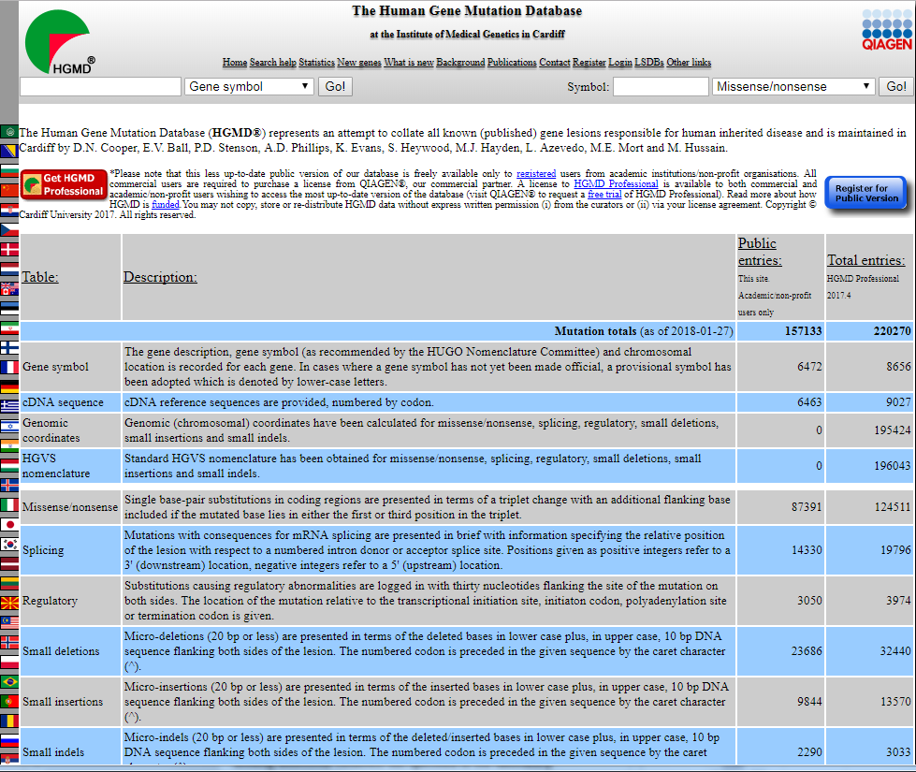
Human Gene Mutation Database (HGMD)
Benefits
Long-standing database (since 1993?)
Best source to identify germline variants reported in the literature
Drawbacks
Database private with high cost
Curators simply enter pathogenic claims from literature which are often wrong
Benign variant claims are not entered
For healthy genome analysis, only 8% of variants reported as pathogenic in HGMD had evidence to support the claim (McLaughlin et al 2014).

Slide 14
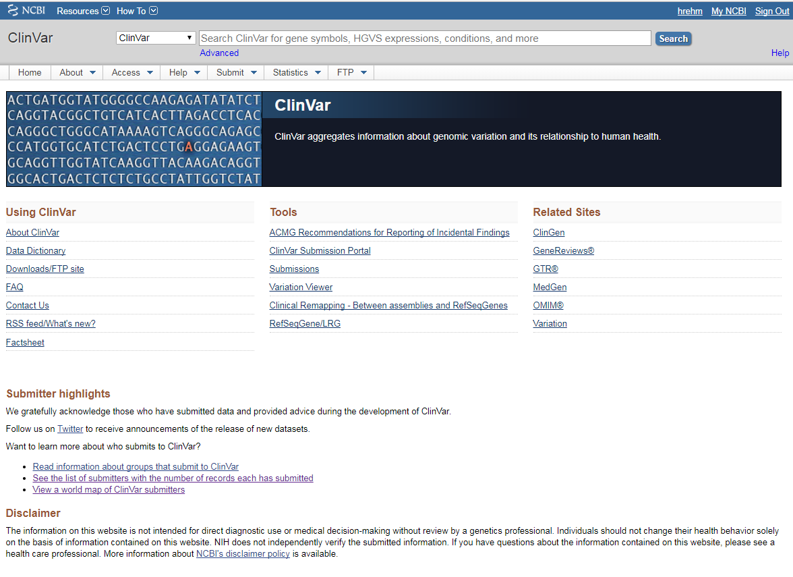
ClinVar
Benefits
Free public database since 2013
Data coming from many sources (clinical labs, researchers, databases, clinics, patient registries)
Majority of data from clinical labs (80%) which is reasonably kept up-to-date
Distinguishes sources by review status
Drawbacks
Fewer structured submissions of case-level data
Quality of interpretations can vary
Supporting evidence not present in 19% of entries

Slide 15
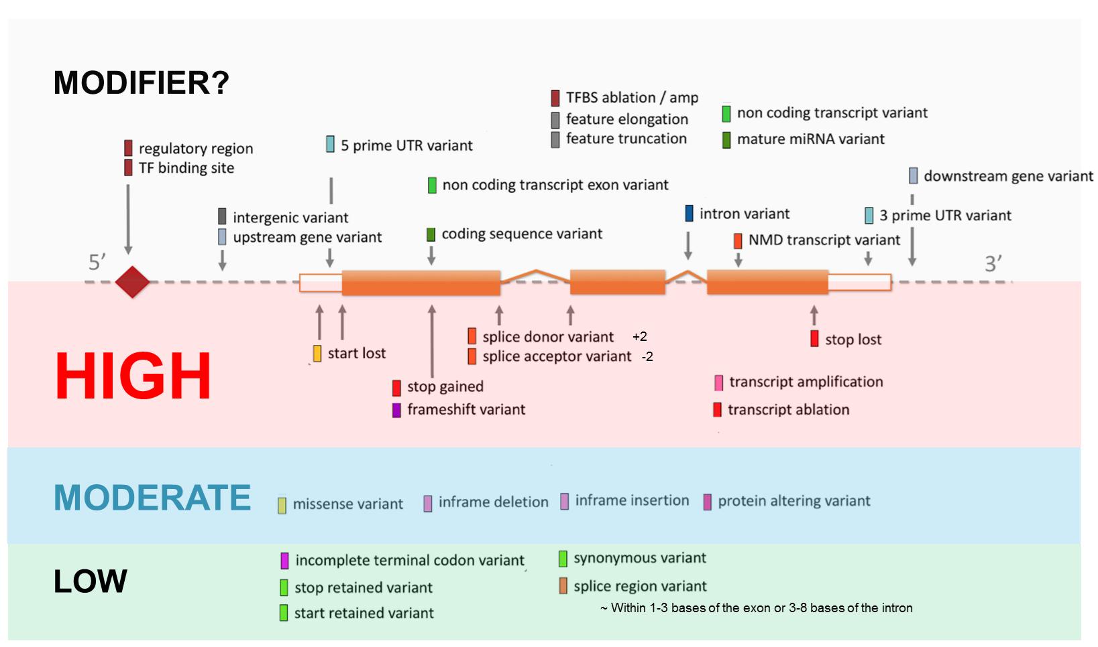
Variant Severity: Variable definitions but helps prioritize

Slide 16
Where is it? Which exon? Regulatory elements nearby? Visualization is key!

Slide 17
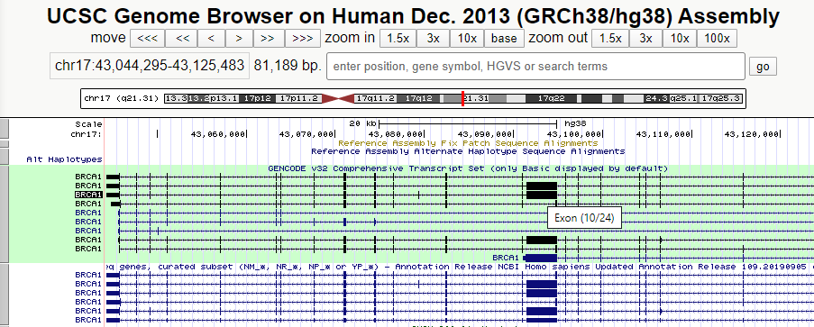
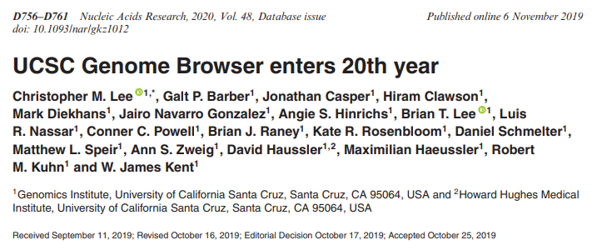
Experimentally Defined Genomic Features: UCSC Genome Browser - Visualization
Web-based viewer for genome sequence data and annotations.
Steadily added data and software features to the website since first coming online in July 2000, and currently hosts 206 assemblies from 105 species
https://genome.ucsc.edu/index.html

Slide 18
Mainstreaming : A focus on end-to-end pathways
Prevention
Early identification/ Prognosis
Diagnosis
Treatment selection
Monitoring/ recurrence
most effective approach – with fewest side-effects
identifying disease predisposition& surveillance
underlying cause of symptoms & features
markers of new/ changed disease
pre-symptomatic disease
+ eligibility for clinical trials
Implications
for family members
Integrated diagnostic reporting informing personalised care

Slide 19
Variant Interpretation: Rationale
Is a previously published variant associated with a disease phenotype pathogenic?
Are all variants observed in a control population benign?
What evidence to we use to ultimately classify a variant?
How do we ensure consistency among clinicians, clinical laboratories, and researchers?

Slide 20
Common framework and criteria for germline variant classification

Slide 21
Common framework and criteria for germline variant classification

Slide 22
We interpret by sorting variants into categories
*Variant: An alteration in the normal sequence of a gene:
A variant that does not appear to have a deleterious effect often associated with a “normal” or no human phenotype.
A variant whose association with disease risk is unknown.
A variant which is proven to be deleterious to protein or gene function and is associated with a particular human phenotype. Or disease
Caution: A deleterious variant is not always pathogenic or disease causing.

Slide 23
The rules proposed to classify sequence variants follows is a heuristic system for variant classification that is compatible with a formal, quantitative, naive Bayesian classifier
B
LB
LP
VUS
P
<1%
10%
Probability of Pathogenicity
90%
99%

Slide 24
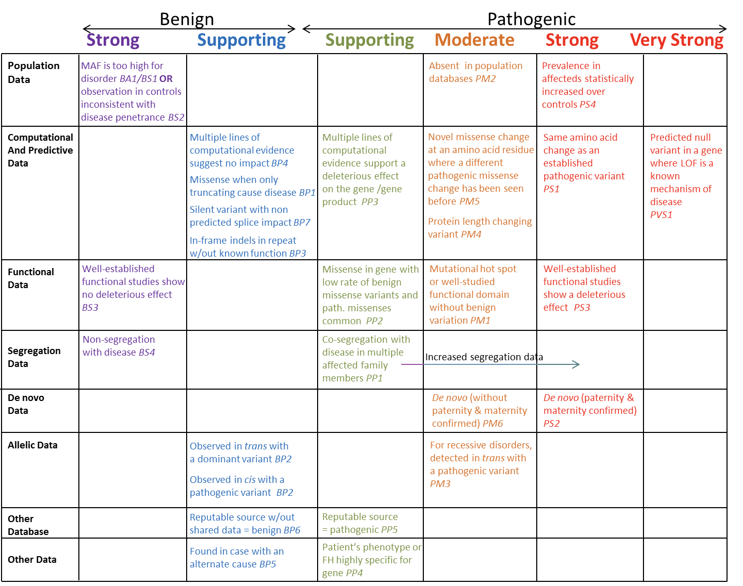

Slide 25
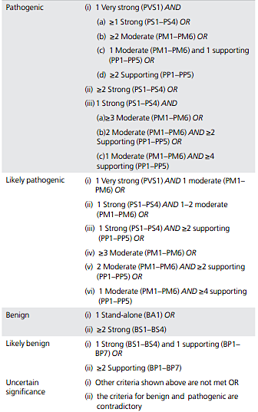
Criteria Nomenclature
Each discrete criteria (benign “B” or pathogenic “P”) with its corresponding level of evidence is combined and together they yield a pathogenicity classification.
PS4 + PM2 + PP1 + BP4 = Likely Pathogenic
Richards CS et al. Gen Med. 2015;17:405-423
Pathogenic
Benign
Level of
Evidence:
Strong
Level of
Evidence:
Supporting
1 strong
1 moderate
1 supporting
Criteria Nomenclature

Slide 26
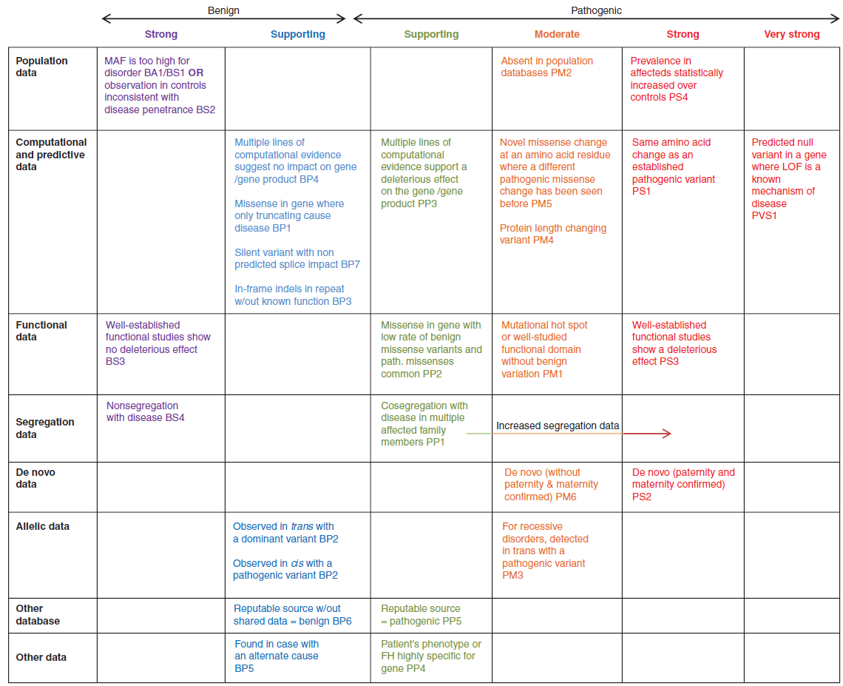
Benign Criteria Example
Segregation
Data
Criterion
Pathogenic Criteria Example
Richards CS et al. Gen Med. 2015;17:405-423

Slide 27
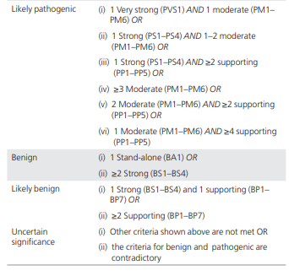
Conflicting Evidence Example
PS4 + PM2 + BP2 + BP4
= Variant of Uncertain
Significance (VUS)
https://www.medschool.umaryland.edu/genetic_variant_interpretation_tool1.html/

Slide 28
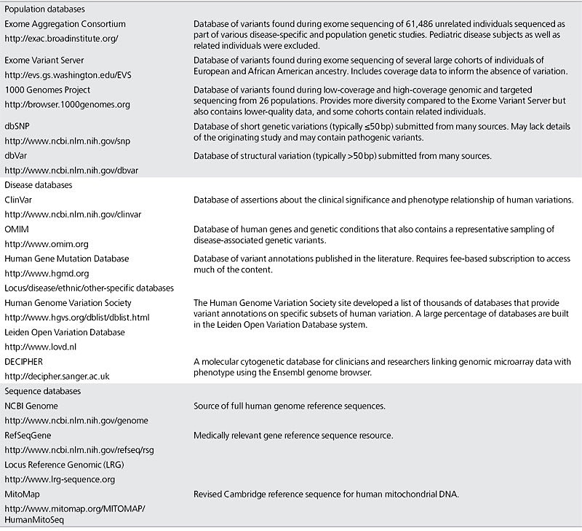
Population, disease-specific, and sequence databases

Slide 29
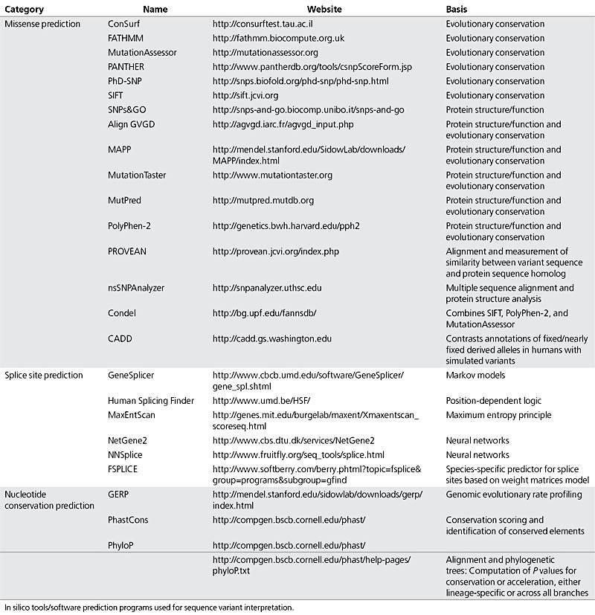
In silico predictive algorithms

Slide 30
Variant Interpretation Framework Summary (11 questions to always ask from a variant)
Concept | Questions |  | ACMG Criteria
Allele Frequency | (1) Common or rare? |  | BA1, BS1, PM2
Computational & Predictive Data | (2) Variant Impact/Type | Loss of function In-frame indel | PVS1 PM4, BP3, BP1
 | (3) In-silico predictions? Potential splicing impact? |  | PP3, BP4 BP7
 | (4) Constraint metrics Gene/regional level |  | PP2
Functional Knowledge | (5) Variant previously studied? |  | PS3, BS3
 | (6) Residue/Domain? Hotspot? |  | PM1 (PS1, PM5)
Clinical Knowledge (published, or case/sample specific) | (7) Interpretation Databases |  | PP5 (PS1, PM5)
 | (7) Previously reported cases? |  | PS4, BS2, BP5
 | (8) Segregation? De novo? |  | PP1, BS4. PS2, PM6
 | (9) Phenotype specificity |  | PP4

Slide 31
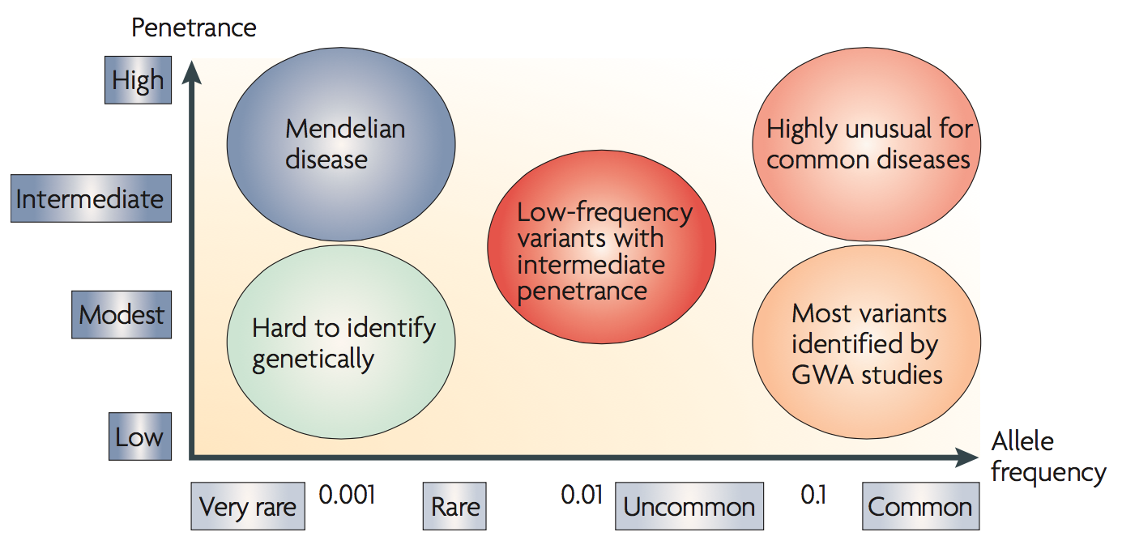
Allele Frequency (BA1, BS1, PM2) How common is this variant?
https://gnomad.broadinstitute.org/

Slide 32
Allele Frequency (BA1, BS1, PM2) How common is this variant?
BA1:
>5% allele frequency in any general continental population of at least 2,000 alleles for a gene without a gene or variant specific recommendation.
BS1:
Allele frequency is greater than expected for disorder (lower than BA1)
PM2:
Absent from controls (or at an extremely low frequency if recessive).
https://gnomad.broadinstitute.org/

Slide 33
http://gnomad.broadinstitute.org/

Slide 34
Variant Interpretation Framework Summary (11 questions to always ask from a variant)
Concept | Questions |  | ACMG Criteria
Allele Frequency | (1) Common or rare? |  | BA1, BS1, PM2
Computational & Predictive Data | (2) Variant Impact/Type | Loss of function | PVS1
 | (3) In-silico predictions? Potential splicing impact? |  | PP3, BP4 BP7
 | (4) Constraint metrics Gene/regional level |  | PP2
Functional Knowledge | (5) Variant previously studied? |  | PS3, BS3
 | (6) Residue/Domain? Hotspot? |  | PM1 (PS1, PM5)
Clinical Knowledge (published, or case/sample specific) | (7) Interpretation Databases |  | PP5 (PS1, PM5)
 | (7) Previously reported cases? |  | PS4, BS2, BP5
 | (8) Segregation? De novo? |  | PP1, BS4. PS2, PM6
 | (9) Phenotype specificity |  | PP4

Slide 35
PVS1
Null variant in a gene where loss of function (LoF) is a known mechanism of disease.
Null Variant Type | Example
Frameshift: | c.2019delA, p.Glu673Aspfs*28
Canonical splice sites: | c.234+2G>A p.?
Nonsense / “stop gain”: | c.1501 A > T, p.K501Ter
Single, multi-exon or gene deletions

Slide 36
Variant Interpretation Framework Summary (11 questions to always ask from a variant)
Concept | Questions |  | ACMG Criteria
Allele Frequency | (1) Common or rare? |  | BA1, BS1, PM2
Computational & Predictive Data | (2) Variant Impact/Type | Loss of function In-frame indel | PVS1 PM4, BP3
 | (3) In-silico predictions? Potential splicing impact? |  | PP3, BP4 BP7
 | (4) Constraint metrics Gene/regional level |  | PP2
Functional Knowledge | (5) Variant previously studied? |  | PS3, BS3
 | (6) Residue/Domain? Hotspot? |  | PM1 (PS1, PM5)
Clinical Knowledge (published, or case/sample specific) | (7) Interpretation Databases |  | PP5 (PS1, PM5)
 | (7) Previously reported cases? |  | PS4, BS2, BP5
 | (8) Segregation? De novo? |  | PP1, BS4. PS2, PM6
 | (9) Phenotype specificity |  | PP4

Slide 37
In-frame removal or insertion of amino acids
Insertions/deletions that occur in repetitive regions are more likely to be of little functional impact; therefore, it is important to assess the surrounding sequence for repetitiveness using a genome browser.
It can also help to assess population databases, such gnomAD, for high confidence variant calls that indicate the site is multi-allelic, which could indicate that the region is prone to indels that are generally tolerated, depending on the overall allele frequency.
It is important to verify the functional impact the deletion or insertion might have. Does it affect the zinc-fingers of a transcription factor? Does it remove important aminoacids in the catalytic site?
PM4
Protein length changes as a result of in-frame deletions/insertions
NM_000179.3(MSH6):
c.535_546del
p.(Ala179_Ala182del)

Slide 38
Stop loss: Protein extending variants
When a variant results in loss of the termination codon (stop-loss variant), the protein is extended; if a variant creates a premature termination codon (nonsense variant), the protein is shortened.
PM4
Protein length changes as a result of in-frame deletions/insertions
PM4
Stop-loss variant
NM_000059.3(BRCA2):
c.10256_10257insT
p.(*3419Tyrext*18)

Slide 39
Variant Interpretation Framework Summary (11 questions to always ask from a variant)
Concept | Questions |  | ACMG Criteria
Allele Frequency | (1) Common or rare? |  | BA1, BS1, PM2
Computational & Predictive Data | (2) Variant Impact/Type | Loss of function In-frame indel | PVS1 PM4, BP3
 | (3) In-silico predictions? Potential splicing impact? |  | PP3, BP4 BP7
 | (4) Constraint metrics Gene/regional level |  | PP2
Functional Knowledge | (5) Variant previously studied? |  | PS3, BS3
 | (6) Residue/Domain? Hotspot? |  | PM1 (PS1, PM5)
Clinical Knowledge (published, or case/sample specific) | (7) Interpretation Databases |  | PP5 (PS1, PM5)
 | (7) Previously reported cases? |  | PS4, BS2, BP5
 | (8) Segregation? De novo? |  | PP1, BS4. PS2, PM6
 | (9) Phenotype specificity |  | PP4

Slide 40
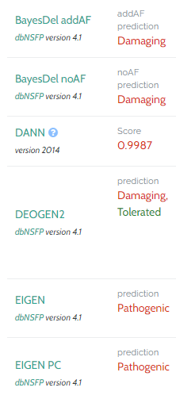
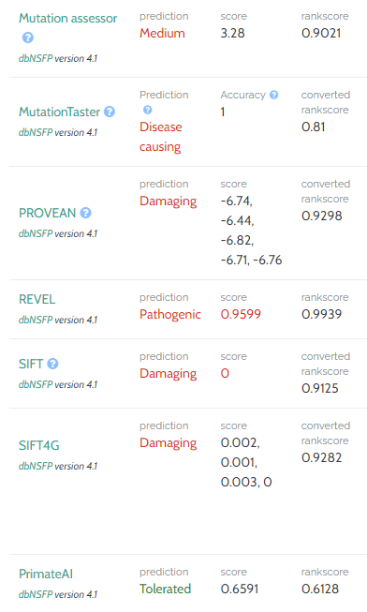
Computational Impact Prediction “In silico scores”
PP3
Multiple lines of computational evidence support a deleterious effect on the gene or
gene product (conservation, evolutionary, splicing impact, etc.)
BP4
Multiple lines of computational evidence suggest no impact on gene or gene product
(conservation, evolutionary, splicing impact, etc.)
Richards CS et al. Gen Med. 2015;17:405-423

Slide 41
Computational Impact Prediction Splicing Scores
PP3
BP4
BP7
A synonymous (silent) variant for which splicing prediction algorithms predict no impact to the splice consensus sequence nor the creation of a new splice site AND the
nucleotide is not highly conserved.
Richards CS et al. Gen Med. 2015;17:405-423

Slide 42
Scores are not deterministic of biological effect/deleteriousness, they are used as “supporting evidence”
gDNA: Chr6(GRCh37):g.51720765A>G
cDNA: NM_138694.3(PKHD1):c.7837T>C
Protein: p.Trp2613Arg
Polyphen-2: Probably damaging
CADD: 29
M-CAP: Probably
PredictSNP2: Deleterious
Scores agree towards SNV being deleterious
Likelihood of pathogenicity is affected, not determined.

Slide 43
Variant Interpretation Framework Summary (11 questions to always ask from a variant)
Concept | Questions |  | ACMG Criteria
Allele Frequency | (1) Common or rare? |  | BA1, BS1, PM2
Computational & Predictive Data | (2) Variant Impact/Type | Loss of function In-frame indel | PVS1 PM4, BP3
 | (3) In-silico predictions? Potential splicing impact? |  | PP3, BP4 BP7
 | (4) Constraint metrics Gene/regional level |  | PP2, BP1 (PM1)
Functional Knowledge | (5) Variant previously studied? |  | PS3, BS3
 | (6) Residue/Domain? Hotspot? |  | PM1 (PS1, PM5)
Clinical Knowledge (published, or case/sample specific) | (7) Interpretation Databases |  | PP5 (PS1, PM5)
 | (7) Previously reported cases? |  | PS4, BS2, BP5
 | (8) Segregation? De novo? |  | PP1, BS4. PS2, PM6
 | (9) Phenotype specificity |  | PP4

Slide 44
Missense Intolerance / Constraint Metrics
Missense variant in a gene that has a low rate of benign missense variation and in which missense variants are a common mechanism of disease. (Uses the “missense z-score”)
PP2
Missense variant in a gene for which primarily truncating variants are known to cause disease.
BP4

Slide 45
Variant Interpretation Framework Summary (11 questions to always ask from a variant)
Concept | Questions |  | ACMG Criteria
Allele Frequency | (1) Common or rare? |  | BA1, BS1, PM2
Computational & Predictive Data | (2) Variant Impact/Type | Loss of function In-frame indel | PVS1 PM4, BP3
 | (3) In-silico predictions? Potential splicing impact? |  | PP3, BP4 BP7
 | (4) Constraint metrics Gene/regional level |  | PP2, BP1
Functional Knowledge | (5) Residue/Domain? Hotspot? |  | PM1
 | (6) Variant previously studied? |  | PS3, BS3
Clinical Knowledge (published, or case/sample specific) | (7) Interpretation Databases |  | PP5 (PS1, PM5)
 | (7) Previously reported cases? |  | PS4, BS2, BP5
 | (8) Segregation? De novo? |  | PP1, BS4. PS2, PM6
 | (9) Phenotype specificity |  | PP4

Slide 46
Mutational Hotspot or
Critical Functional Domain
PM1
Located in a mutational hot spot and/or critical and well established functional domain (ex. Active site of an enzyme) without benign variation
What/who determines the size or location of a mutational hotspot?
Where can I find an established functional domain for a particular gene/protein product?
UNIPROT

Slide 47
https://www.uniprot.org/uniprot/P43246

Slide 48
Variant Interpretation Framework Summary (11 questions to always ask from a variant)
Concept | Questions |  | ACMG Criteria
Allele Frequency | (1) Common or rare? |  | BA1, BS1, PM2
Computational & Predictive Data | (2) Variant Impact/Type | Loss of function In-frame indel | PVS1 PM4, BP3
 | (3) In-silico predictions? Potential splicing impact? |  | PP3, BP4 BP7
 | (4) Constraint metrics Gene/regional level |  | PP2, BP1
Functional Knowledge | (5) Residue/Domain? Hotspot? |  | PM1
 | (6) Variant effect functionally studied? |  | PS3, BS3
Clinical Knowledge (published, or case/sample specific) | (7) Interpretation Databases |  | PP5 (PS1, PM5)
 | (7) Previously reported cases? |  | PS4, BS2, BP5
 | (8) Segregation? De novo? |  | PP1, BS4. PS2, PM6
 | (9) Phenotype specificity |  | PP4

Slide 49
Functional Evidence:
PS3
Well-established in vitro or in vivo functional studies supportive of a damaging effect on the gene or gene product.
Functional studies that have been validated and shown to be reproducible and robust in a clinical diagnostic laboratory setting are considered the most well established.
What defines a “well established” functional
study or assay?
How reliable? This is not simple.
BS3
Well-established in vitro or in vivo functional studies show no damaging effect on protein function or splicing
Richards CS et al. Gen Med. 2015;17:405-423

Slide 50
Variant Interpretation Framework Summary (11 questions to always ask from a variant)
Concept | Questions |  | ACMG Criteria
Allele Frequency | (1) Common or rare? |  | BA1, BS1, PM2
Computational & Predictive Data | (2) Variant Impact/Type | Loss of function In-frame indel | PVS1 PM4, BP3
 | (3) In-silico predictions? Potential splicing impact? |  | PP3, BP4 BP7
 | (4) Constraint metrics Gene/regional level |  | PP2, BP1
Functional Knowledge | (5) Residue/Domain? Hotspot? |  | PM1
 | (6) Variant effect functionally studied? |  | PS3, BS3
Clinical Knowledge (published, or case/sample specific) | (7) Interpretation Databases - ClinVar |  | PP5 , PM5, PS1
 | (8) Previously reported cases? |  | PS4, BS2, BP5
 | (9) Phenotype specificity |  | PP4
 | (10) Segregation? De novo? |  | PP1, BS4. PS2, PM6
 | (11) Trans / cis observations |  | PM3, BP2

Slide 51
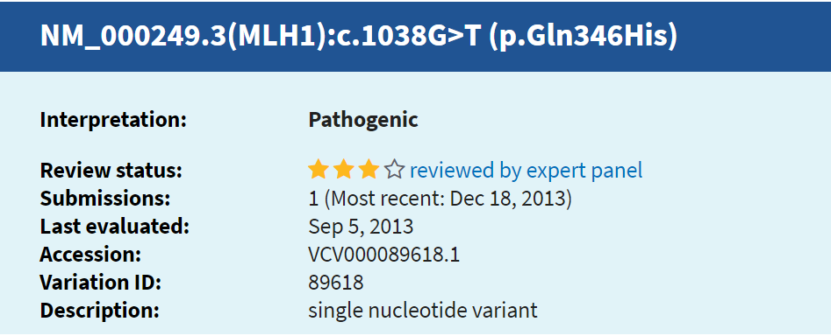
Knowledge Databases \ Previous Interpretations – ClinVar, HGMD
Variant of Interest: NM_000249.3(MLH1):c.1038G>T (p.Gln346His) (p.Q346H)
PP5
Reputable source recently reports variant as pathogenic, but the evidence is not available to the laboratory to perform an independent evaluation
BP6
Reputable source recently reports variant as benign
but the evidence is not available to the laboratory to perform an independent evaluation
http://clinvar.com/

Slide 52
Knowledge Databases \ Previous Interpretations – ClinVar, HGMD
Variant of Interest: NM_000249.3(MLH1):c.1038G>T (p.Gln346His) (p.Q346H)
PM5
Missense change at an amino acid residue
where a different missense change previously
established as pathogenic
c.1037A>G (p.Gln346Arg) (p.Q346R)
PS1
Same amino acid change as a previously
established pathogenic variant regardless of nucleotide change
c.1038G>(p.Gln346His) (p.Q346H)
http://clinvar.com/

Slide 53
Variant Interpretation Framework Summary (11 questions to always ask from a variant)
Concept | Questions |  | ACMG Criteria
Allele Frequency | (1) Common or rare? |  | BA1, BS1, PM2
Computational & Predictive Data | (2) Variant Impact/Type | Loss of function In-frame indel | PVS1 PM4, BP3
 | (3) In-silico predictions? Potential splicing impact? |  | PP3, BP4 BP7
 | (4) Constraint metrics Gene/regional level |  | PP2, BP1
Functional Knowledge | (5) Residue/Domain? Hotspot? |  | PM1
 | (6) Variant effect functionally studied? |  | PS3, BS3
Clinical Knowledge (published, or case/sample specific) | (7) Interpretation Databases - ClinVar |  | PP5 , PM5, PS1
 | (8) Previously reported cases? |  | PS4, BS2, BP5
 | (9) Phenotype specificity |  | PP4
 | (10) Segregation? De novo? |  | PP1, BS4. PS2, PM6
 | (11) Trans / cis observations |  | PM3, BP2

Slide 54
Variant Interpretation Framework Summary (11 questions to always ask from a variant)
Concept | Questions |  | ACMG Criteria
Allele Frequency | (1) Common or rare? |  | BA1, BS1, PM2
Computational & Predictive Data | (2) Variant Impact/Type | Loss of function In-frame indel | PVS1 PM4, BP3
 | (3) In-silico predictions? Potential splicing impact? |  | PP3, BP4 BP7
 | (4) Constraint metrics Gene/regional level |  | PP2, BP1
Functional Knowledge | (5) Residue/Domain? Hotspot? |  | PM1
 | (6) Variant effect functionally studied? |  | PS3, BS3
Clinical Knowledge (published, or case/sample specific) | (7) Interpretation Databases - ClinVar |  | PP5 , PM5, PS1
 | (8) Previously reported cases? |  | PS4, BS2,
 | (9) Phenotype specificity |  | PP4
 | (10) Segregation? De novo? |  | PP1, BS4. PS2, PM6
 | (11) Trans / cis observations |  | PM3, BP2

Slide 55
Specific Phenotype
PP4
Patient’s phenotype or family history is highly specific for a disease with a single mono genetic etiology.
Disorders with specific biochemical findings are easier to account for in this criterion than those with non-specific phenotype like “neurodevelopmental delays” or “dysmorphologies”.
Functional evidence from patient-derived material best reflects the organismal phenotype and, in general, it would be better to use this evidence to satisfy PP4 (specific phenotype)

Slide 56
Variant Interpretation Framework Summary (11 questions to always ask from a variant)
Concept | Questions |  | ACMG Criteria
Allele Frequency | (1) Common or rare? |  | BA1, BS1, PM2
Computational & Predictive Data | (2) Variant Impact/Type | Loss of function In-frame indel | PVS1 PM4, BP3
 | (3) In-silico predictions? Potential splicing impact? |  | PP3, BP4 BP7
 | (4) Constraint metrics Gene/regional level |  | PP2, BP1
Functional Knowledge | (5) Residue/Domain? Hotspot? |  | PM1
 | (6) Variant effect functionally studied? |  | PS3, BS3
Clinical Knowledge (published, or case/sample specific) | (7) Interpretation Databases - ClinVar |  | PP5 , PM5, PS1
 | (8) Previously reported cases? |  | PS4, BS2, BP5
 | (9) Phenotype specificity |  | PP4
 | (10) Segregation? De novo? |  | PP1, BS4. PS2, PM6
 | (11) Trans / cis observations |  | PM3, BP2

Slide 57
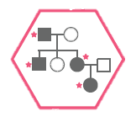
Case-Specific Evidence - Segregation Data
PP1
Co-segregation with disease in multiple affected family members of a single family in a gene definitively known to cause the disease.
Note: May be used as stronger evidence with increasing segregation data.

Slide 58
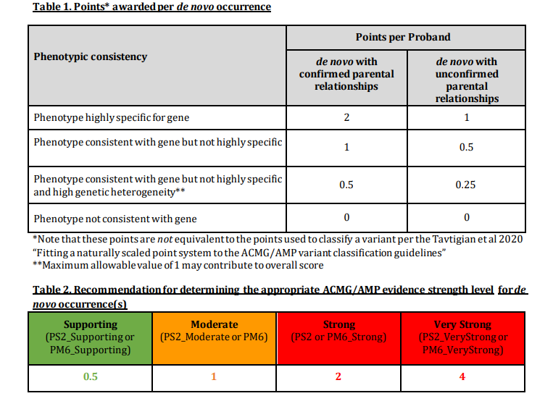
Case-Specific Evidence – De novo occurrence
PS2
De novo (both maternity and paternity confirmed) in a patient with the disease and no family history.
PM6
De novo (maternity and paternity not confirmed) in a patient with the disease and no family history.
https://www.clinicalgenome.org/site/assets/files/3461/svi_proposal_for_de_novo_criteria_v1_1.pdf

Slide 59
Variant Interpretation Framework Summary (11 questions to always ask from a variant)
Concept | Questions |  | ACMG Criteria
Allele Frequency | (1) Common or rare? |  | BA1, BS1, PM2
Computational & Predictive Data | (2) Variant Impact/Type | Loss of function In-frame indel | PVS1 PM4, BP3
 | (3) In-silico predictions? Potential splicing impact? |  | PP3, BP4 BP7
 | (4) Constraint metrics Gene/regional level |  | PP2, BP1
Functional Knowledge | (5) Residue/Domain? Hotspot? |  | PM1
 | (6) Variant effect functionally studied? |  | PS3, BS3
Clinical Knowledge (published, or case/sample specific) | (7) Interpretation Databases - ClinVar |  | PP5 , PM5, PS1
 | (8) Previously reported cases? |  | PS4, BS2, BP5
 | (9) Phenotype specificity |  | PP4
 | (10) Segregation? De novo? |  | PP1, BS4. PS2, PM6
 | (11) Trans / cis observations |  | PM3, BP2

Slide 60
Case-Specific Evidence – Phase Evidence
PM6
For recessive disorders, detected in trans with a pathogenic variant.
This requires testing of parents (or offspring) to determine phase.
BP2
Observed in trans with a pathogenic variant for a fully penetrant dominant gene/disorder or observed in cis with a pathogenic variant in any inheritance pattern.
https://www.clinicalgenome.org/site/assets/files/3717/svi_proposal_for_pm3_criterion_-_version_1.pdf

Slide 61
H - NM_000277.2:c.1147C>T (p.Gln383Ter)
PAH established causal gene for
phenylketonuria (PKU)
Variant is loss-of-function and in a gene in which loss-of-function causes disease
PVS1 applied
Variant found in 1/16,254 (0.006%) in African chromosomes in gnomAD
PM2 applied
Variant observed in 1 proband with classic PKU who also carried variant p.Arg408Trp in trans (variant called Pathogenic by 18 labs in ClinVar)
PM3 applied
In total have PVS1, PM2, and PM3 applied = 1 Pathogenic Very Strong and 2 Pathogenic Moderate

Slide 62
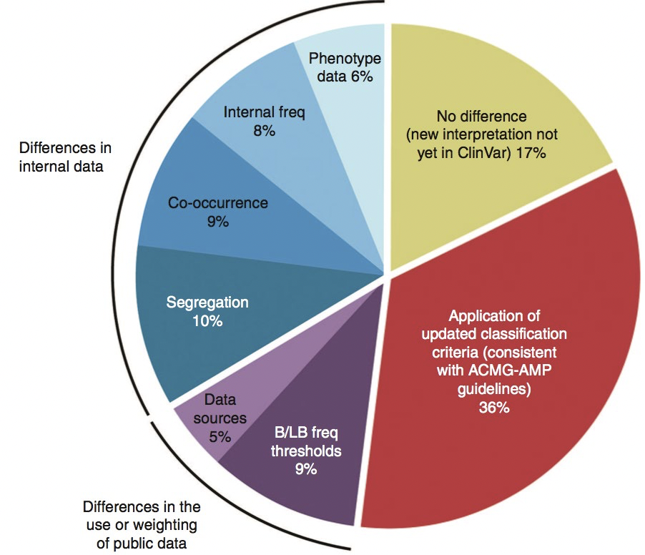
Implementation of ACMG/AMP guidelines has increased interpretation concordance between labs
>1/3 discrepancies due to differences in classification algorithms
Inconsistencies in application of ACMG/AMP criteria

Slide 63
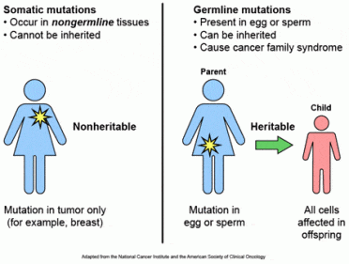
Warning! Germline and Somatic Classification and Catalogue Differences

Slide 64
Warning! Germline and Somatic Classification and Catalogue Differences
Categories:
Diagnostic
Prognostic
Therapeutic
Categories:
Pathogenic
Likely Pathogenic
VUS – Variant of Uncertain Significance
Likely Benign
Benign

Slide 65
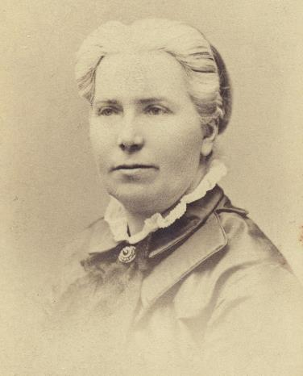
“It’s not easy to be a pioneer – but oh, is it fascinating”
Elizabeth Blackwell

