Slide 2
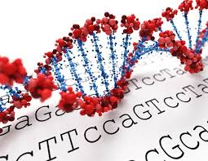
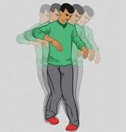
Genetics in Ataxia
Zahra Rezaei, Pediatric Neurologist, MD
December 2021

Slide 3
Goals
Differential Diagnosis in Ataxia
Definition of Ataxia
Diagnostic tools
Diagnostic Algorithm

Slide 4
Dizziness
Dizziness is a term used to describe a range of sensations, such as feeling faint, woozy, weak or unsteady.
Light headedness, presyncopal symptoms

Slide 5
Different presentation in different ages
Infant
Toddler
Preschool children
Nausea/vomiting ֎ vestibular abnormality

Slide 6
Vertigo
Dizziness that creates the false sense that you or your surroundings are spinning or moving is called vertigo.

Slide 7
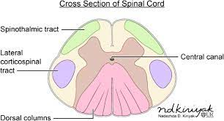
Posterior Column
ascending sensory pathways that carry information about tactile sensations and proprioception.

Slide 8
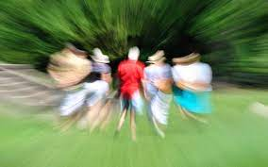
Evaluation
History
Examination
Laboratory workup

Slide 9
History
Patient’s words
Associated sign/symptoms: nausea, vomiting, hearing loss, tinnitus, seizure, altered consciousness, cranial nerve involvement, numbness, nystagmus,
Onset/Duration/ Frequency
Triggering factors: change in position, sleep deprivation, coughing/sneezing, emotional stressor

Slide 10
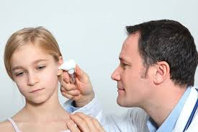
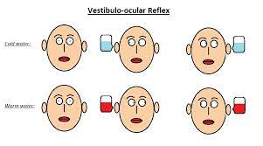
Evaluation
Videonystagmography
Caloric Test
Rotational test
Computerized Dynamic Platform Posturography
Vestibular- Evoked Myogenic Potential

Slide 11
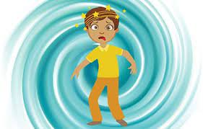
Childhood Dizziness Causes
Non-recurrent vertigo
Recurrent Vertigo
Nonvertiginous Dizziness

Slide 13
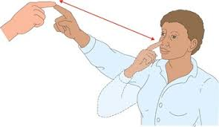
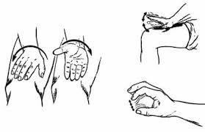
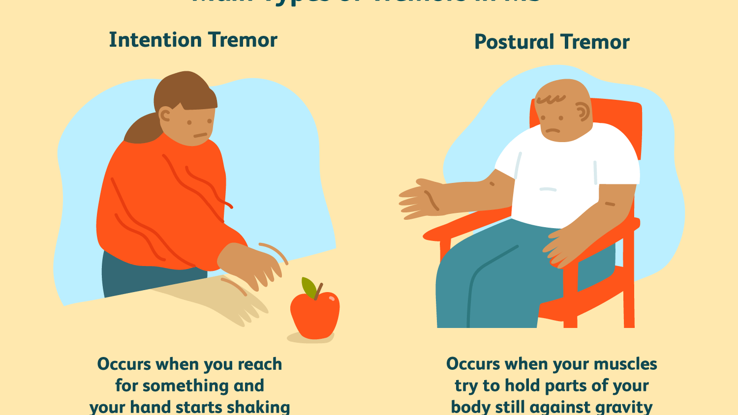
Ataxia

Slide 14
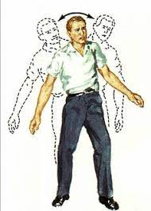
Definition
Lack of order
Disturbance in smooth performance of voluntary motor acts
Abasia ( inability to walk due to spasticity, chorea, tremor)
Asynergia (lack of coordination between parts that normally
act together)
Dysmetria(inability to estimate distance)
Dysdiadochokinesia
Ataxic gait
Vermal lesion→ Truncal ataxia, titubation
Hemispheric lesion→ Limb ataxia

Slide 15
Cerebellum: Little brain

Slide 16
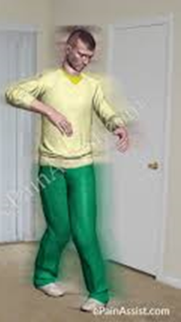
Cerebellar Functions
1.Coordination of motor movements
2.Direct motor learning
3.Non-motor functions: Sensory discrimination, attention, working memory, verbal learning, complex problem solving
4. Various higher order cognitive process(Hemispheres and dentate nuclei)

Slide 17
Diagnostic Tools
History
Neurologic/ General Examinations
Laboratory Data
Electrodiagnosis
Neuroimaging (MRI)
Genetic Tests

Slide 18
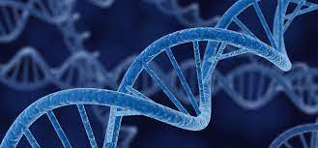
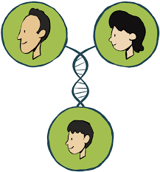
Hereditary Ataxia
- Two main classes:
1.Enzymatic defects: AR, presented in childhood, some are treatable
2.Progressive degenerative ataxia: AR( Friedreich's, SCA), AD(SCA, Episodic ataxia, DRPLA), X- linked( FXTAS)
SCA: Spino Cerebellar Ataxia
DRPLA: dentate-rubropallidoluysian atrophy
FXTAS: Fragil X-associated Tremor/Ataxia Syndrome

Slide 19
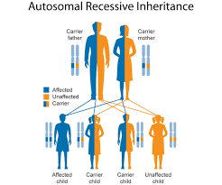
Autosomal Recessive Ataxia
1.Friedreich ataxia(FRDA,GAA repeat +200)
2. AVED
3.AT(ATM)- ↓IgA & IgE ,↑AFP& CEA
4.AT like
5. AOA1(APTX, aprataxin)- ↑ chol, ↓Alb
6. AOA2(SETX, senataxin)- ↑AFP
7. SCA(Spino Cerebellar Ataxia)- more than 17 types

Slide 20
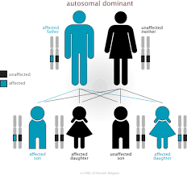
Autosomal Dominant Ataxia
1- SCA( more than 40 types)
2-Episodic ataxia type ( 8 types)- Ionic channel involvement- acetazolamide- EA2 & FHM( CACNA1A)
3.Hereditary spastic ataxia( AR,AD,X-linked)

Slide 21
X-Linked Ataxia
- FXTAS
Fragile X- associated Tremor/Ataxia syndrome
Older relative of fragile x syndrome children
gene: FMR1
CGG repeat

Slide 22
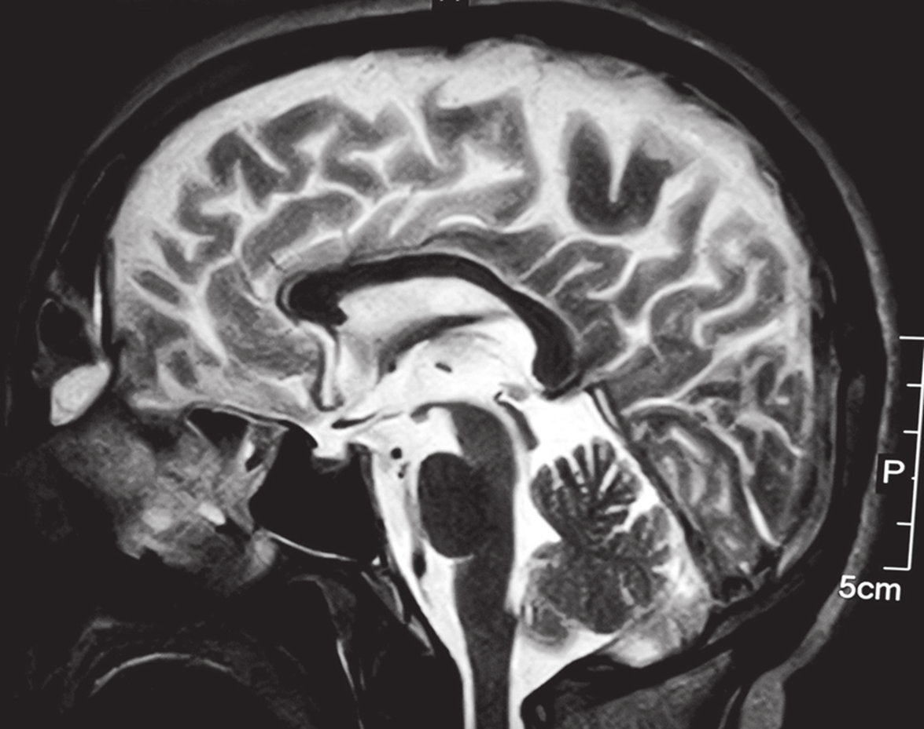
Neuroimaging /MRI

Slide 23
Vermis Atrophy

Slide 24
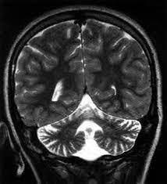
Cerebellar Atrophy

Slide 25
Upper Cervical Atrophy

Slide 26
Diagnostic Algorithm in Ataxia

Slide 29
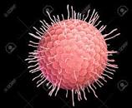
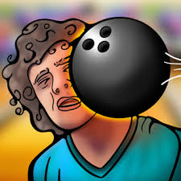
Non-hereditary/acute Ataxia
1.Viruses(rubella, varicella, coxaki)
2.Trauma
3.Toxins(Alcohol, barbiturates, AED)
4. Congenital malformation(Chiari, Dandy-Walker)
5.Tumors(pontine glioma, angioblastoma)
6.Metabolic(hypothyroidism)
7.Autoimmune disorders( gluten sensitivity)

Slide 34
Abbreviations
SANDO (Sensory Ataxic Neuropathy, Dysarthria, Ophthalmoparesis)
Autosomal recessive spastic ataxia of Charlevoix-Saguenay (ARSACS)
Autosomal recessive cerebellar ataxia type 1 (ARCA-1)
Niemann-Pick disease type C (NPC)
Ataxia with vitamin E deficiency (AVED)
Congenital disorder of glycosylation type Ia (CDG-Ia)
AT: Ataxia-telangiectasia
AOA1,2: Ataxia with oculomotor apraxia 1,2

